Slide 1
Research at Penn Part 1: what, where, when, who, and WHY
Mark Neuman
Associate Faculty Director of Medical Student Scholarship, PSOM

Slide 2

PSOM Associate Faculty Director for Medical Student Scholarship & Research
New position established 7/1/2021
Promote and coordinate all elective research for non-MD/PhD medical students, including summer & year out opportunities
Direct the year 4 scholarly pursuit requirement
Mark Neuman, MD, MSc
Horatio C. Wood Associate Professor of Anesthesiology and Critical Care
Co-Director, Penn Center for Perioperative Outcomes Research and Transformation (Penn CPORT)
neumanm@pennmedicine.upenn.edu

Slide 3
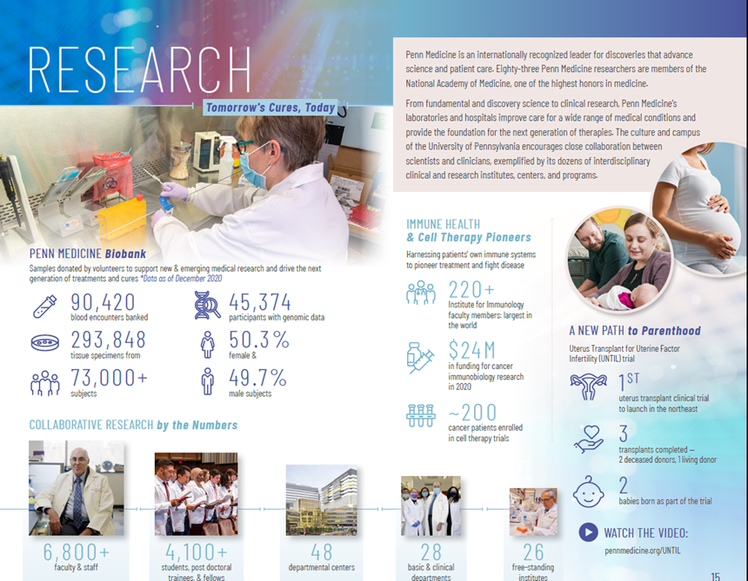
Penn is research
Grants and contracts (2020):
  9,277 awards totaling $1.26B across 12 schools university-wide
  $890M within Penn Medicine
  1,794 PIs submitted 4,559 projects
178 research centers and institutes campus-wide
5,000 research faculty
5,700 academic support staff and graduate student trainees
Total research budget: $1.1 billion
https://www.pennmedicine.org/news/publications-and-special-projects/facts-and-figures

Slide 4

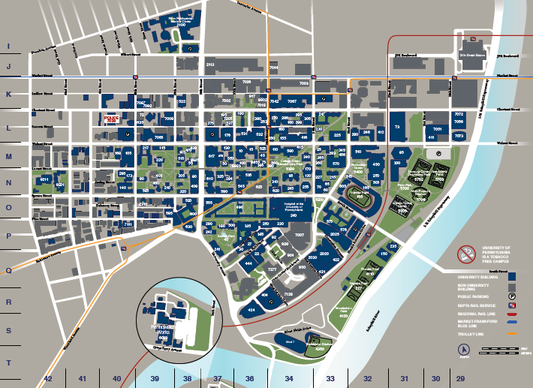


Slide 5
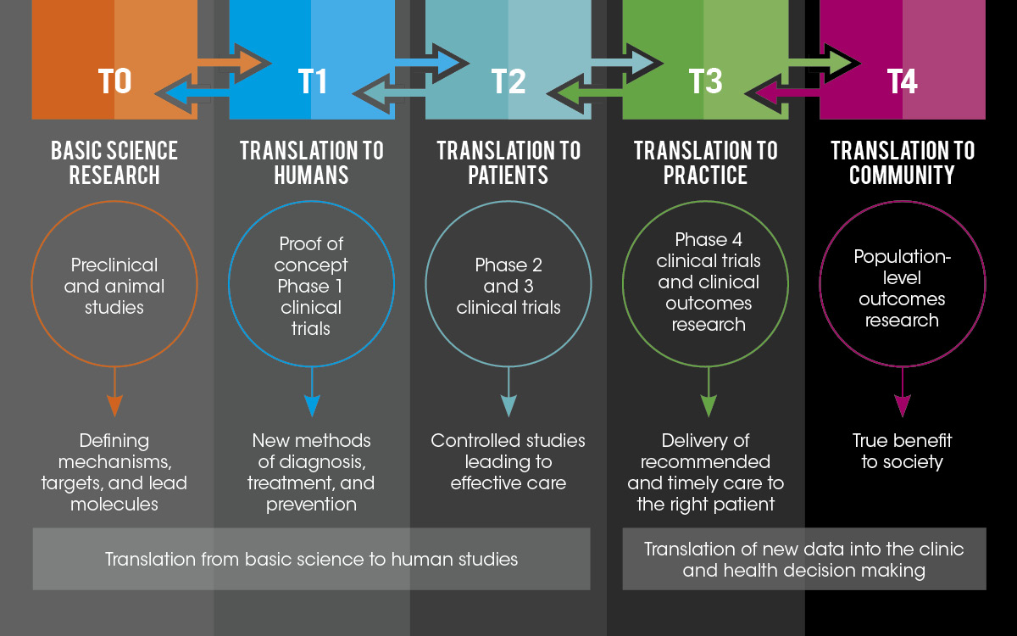

Slide 6
Why do research?
Build relationships
Develop skills
Demonstrate excellence
Learn about a specialty/topic
Make a difference

Slide 7
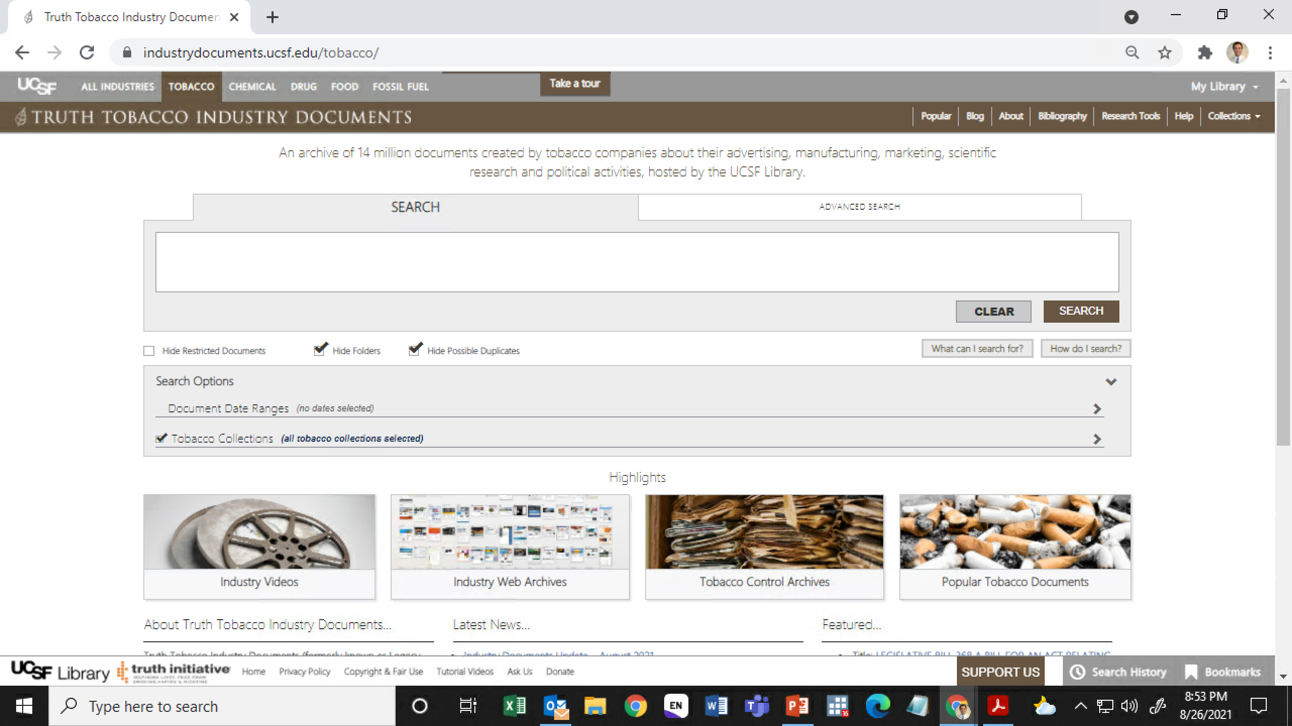

Slide 8
Questions to ask yourself at the start
What are you interested in?
How much time do you have available?
What do you want to get out of your research experience?
What can I offer?
  “Fresh eyes”
  Energy
  Enthusiasm
  Motivation
  Persistence

Slide 9
WHEN to get involved
Summer between 1st & 2nd year
In between time during preclinical & clinical years
Scholarly year out
MD+ degree (MSCE, MSHP, MBE)
MD/PhD Medical Scientist Training Program (MSTP)
4th Year (Scholarly Pursuit)

Slide 10
Scholarly Pursuit
A focused, mentored full-time commitment. The project must revolve around a specific hypothesis and work that aims to test it. The Scholarly Pursuit can be fulfilled in one of three ways:
  A three-month project
  A yearlong project, post Module 4
  By earning a second degree after matriculation into medical school
3mo/1y year projects result in a 10p research report or submitted manuscript
Elective research outside of dedicated SP time will not itself fulfill the requirement, but SP work can build on other elective research completed during (or prior to) your time at Penn
https://www.med.upenn.edu/student/scholarly-pursuit.html
Project-Related Support |  | Administrative/Arranged Activities Support
Dr. Mark Neuman | neumanm@pennmedicine.upenn.edu | Christopher Veitz | cveitz@pennmedicine.upenn.edu
Dr. Jen Kogan | Jennifer.Kogan2@pennmedicine.upenn.edu | Beth Marra | McneelyB@pennmedicine.upenn.edu
Dr. Lawrence Brass | Lawrence.Brass@pennmedicine.upenn.edu | Charita Brown | charita@pennmedicine.upenn.edu

Slide 11
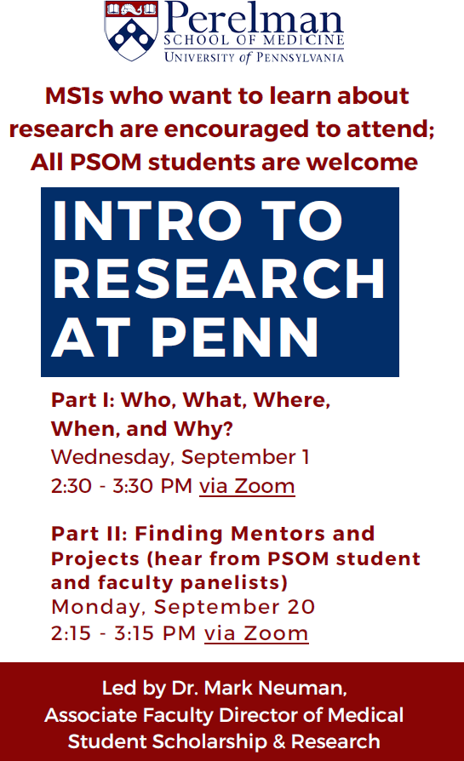
The first step: finding a faculty mentor
Many (but not all) Penn faculty are engaged in research, but variability across faculty in terms of:
  Importance for promotion/advancement
  Time available for research & mentoring
  Training/experience/expertise
All Penn faculty teach
Worth taking the time to find a faculty member who can mentor you effectively on a research project
More on this on 9/20

Slide 12
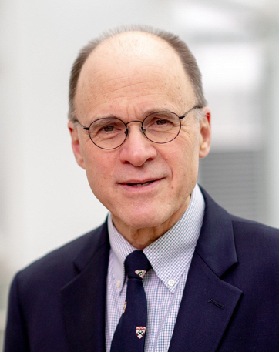
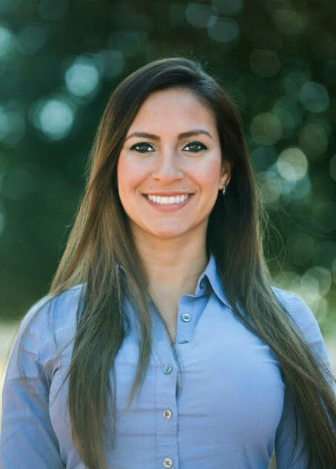
Office of Combined Degree & Physician Scholar Programs
Skip Brass, MD PhD
Professor of Medicine and Pharmacology
Associate Dean, Combined Degree and Physician Scholars Program
brass@pennmedicine.upenn.edu
Francia Portacio
Associate Director, Combined Degree and Physician Scholars Program
francia.portacio@pennmedicine.upenn.edu

Slide 13
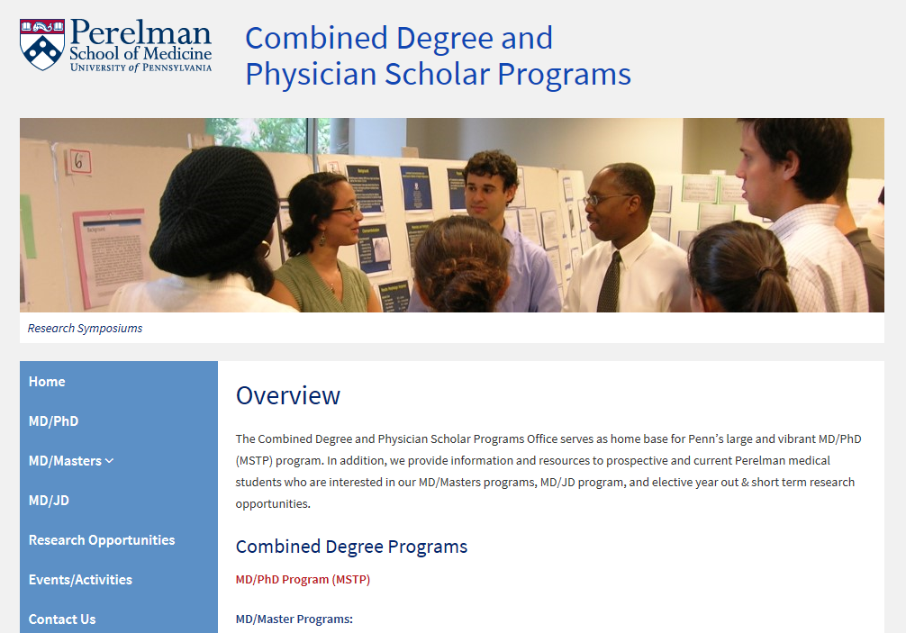
http://www.med.upenn.edu/educ_combdeg/

Slide 14
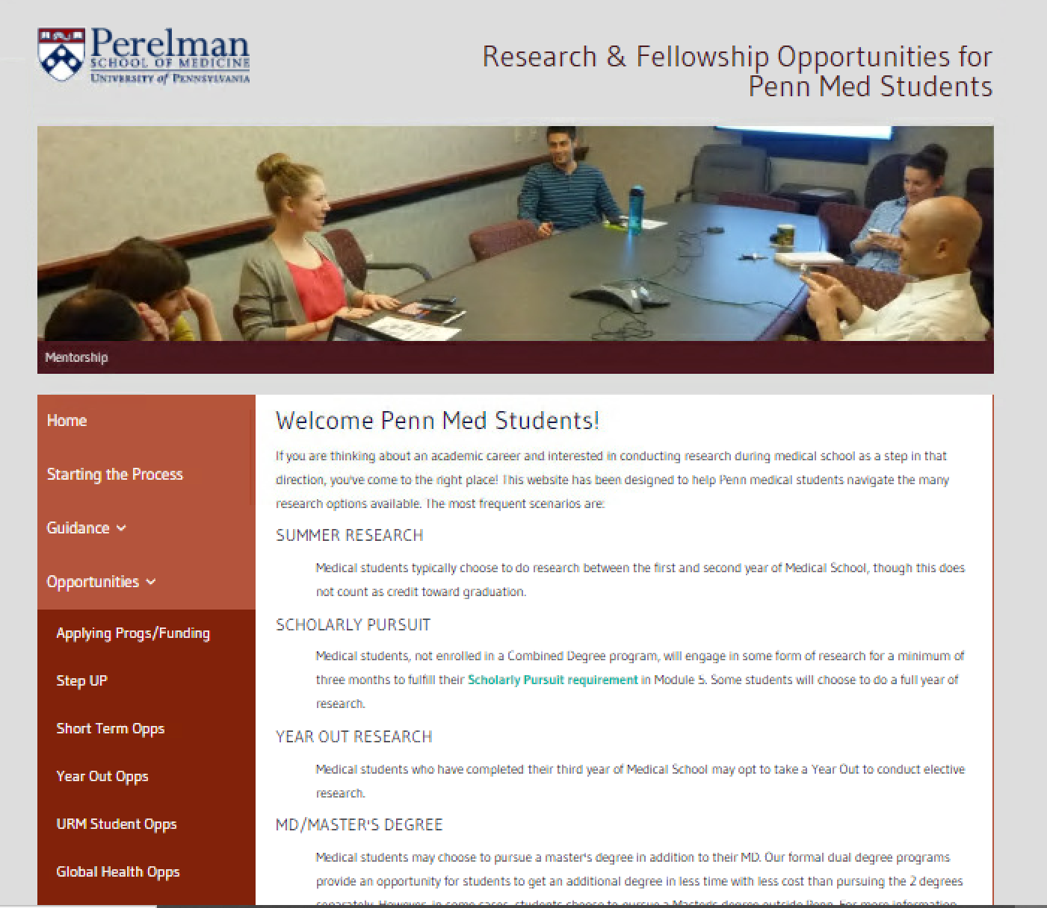
Short Term/Year Out/URM/Global Health Opps: funding & fellowship opportunity postings
StepUP: Searchable database of projects with current needs
Other resources: guidance on the research process, finding mentors, applying for summer or year-out funding
Presenting at a conference: APO can cover up to $500 (per fiscal year) for costs related to registration, transportation, lodging or printing

Slide 15
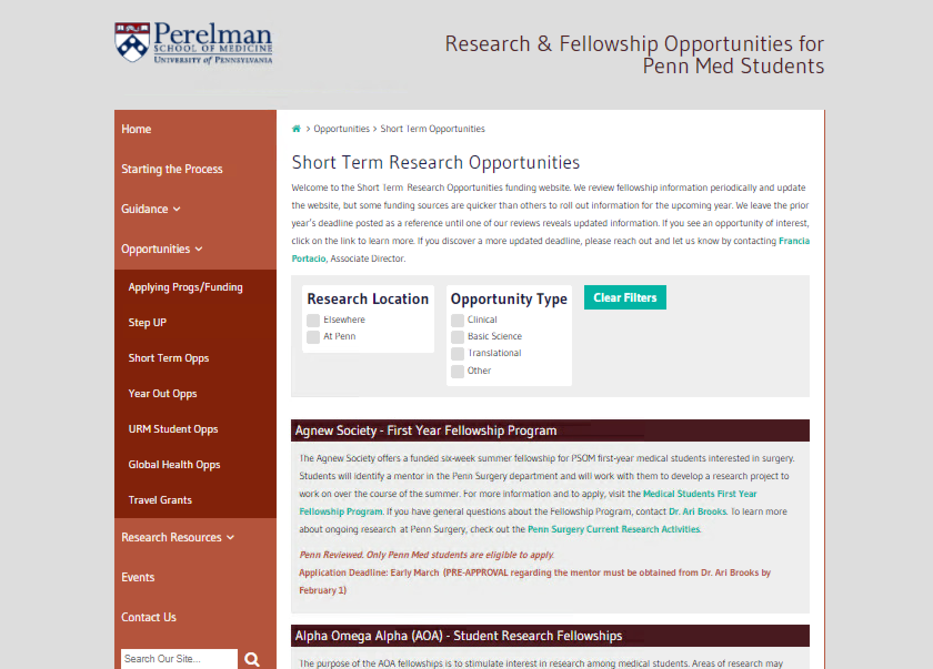

Slide 16
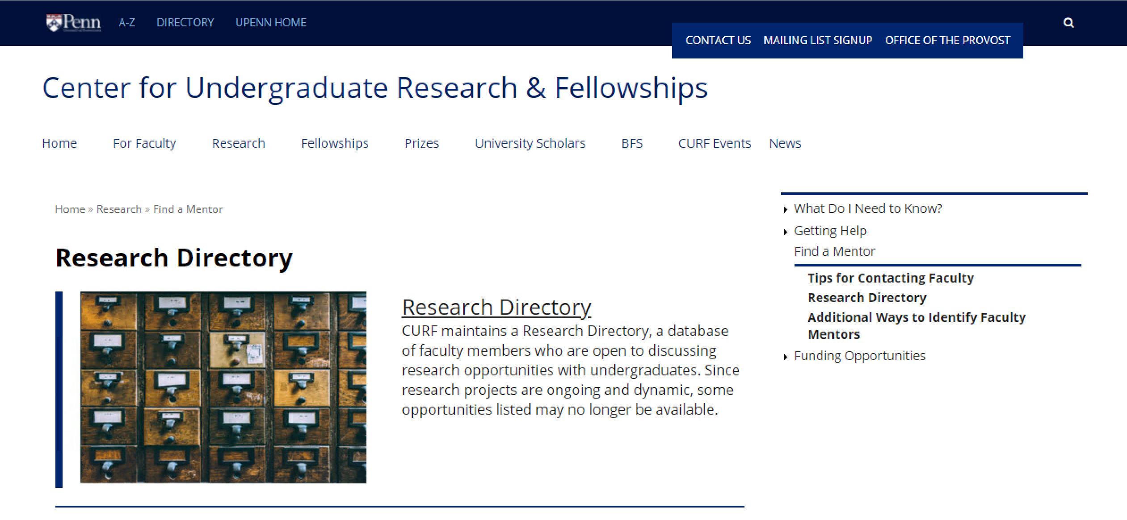
https://www.curf.upenn.edu/research/find-mentor/research-opportunity-directory

Slide 17
The (scientific) research process
Define the problem
Review the literature
Define research questions & hypotheses
Define data collection strategy & plan analysis
Decide on the sample design
Choose the study design
Collect data
Analyze data
Write the report & share findings

Slide 18
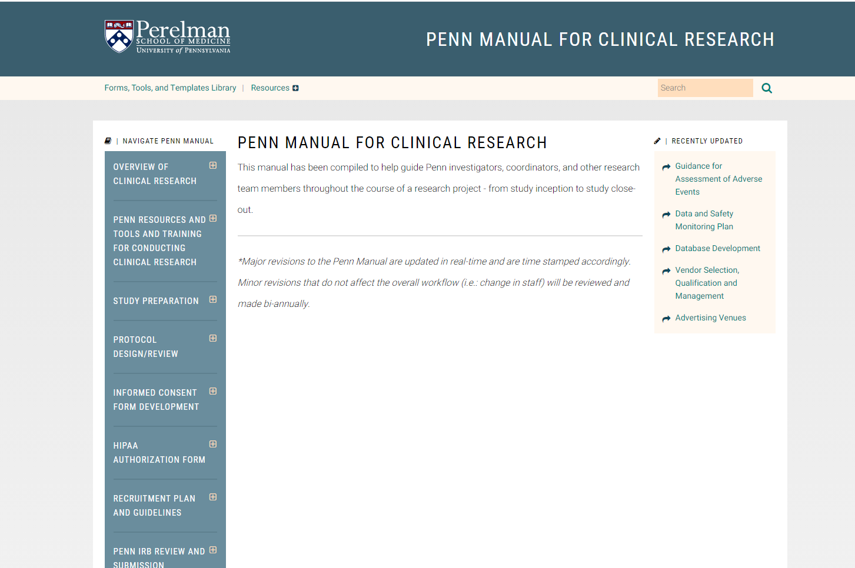
https://www.med.upenn.edu/pennmanual/secure/

Slide 19
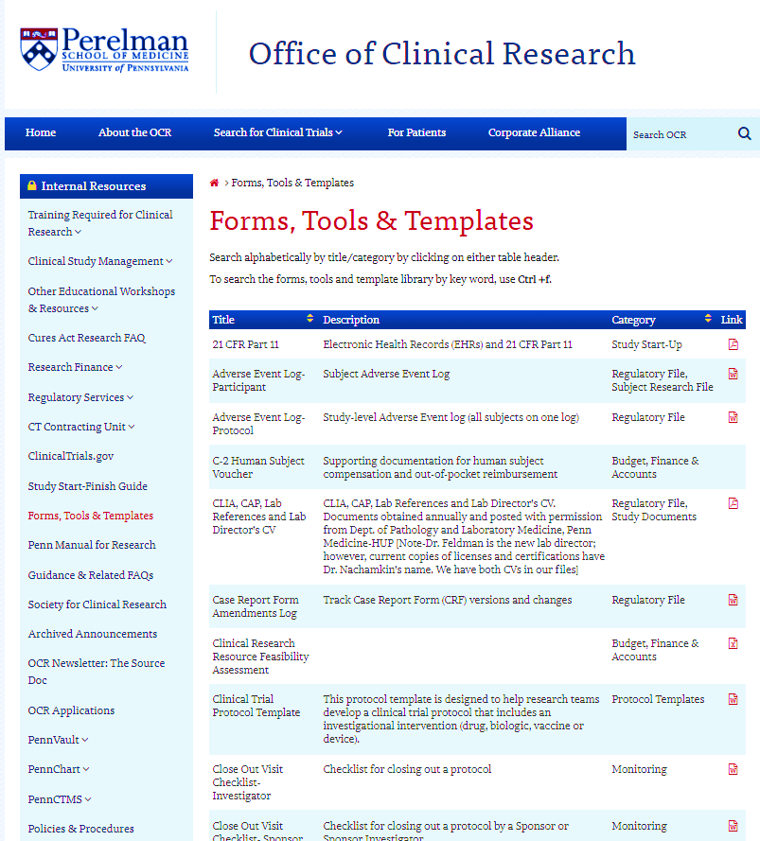

Slide 20
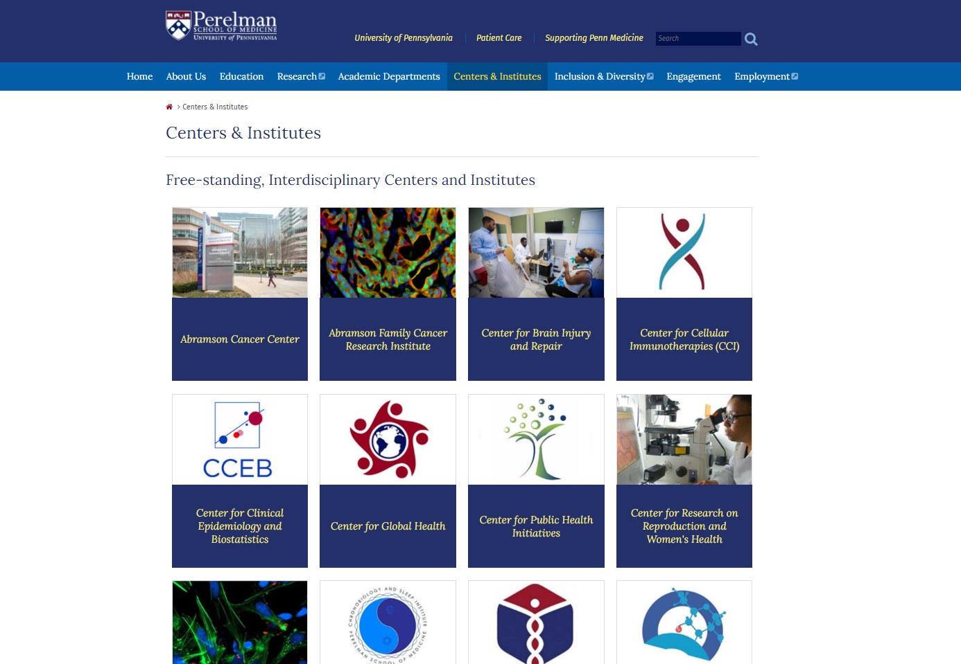
https://www.med.upenn.edu/psom/centers.html

Slide 21
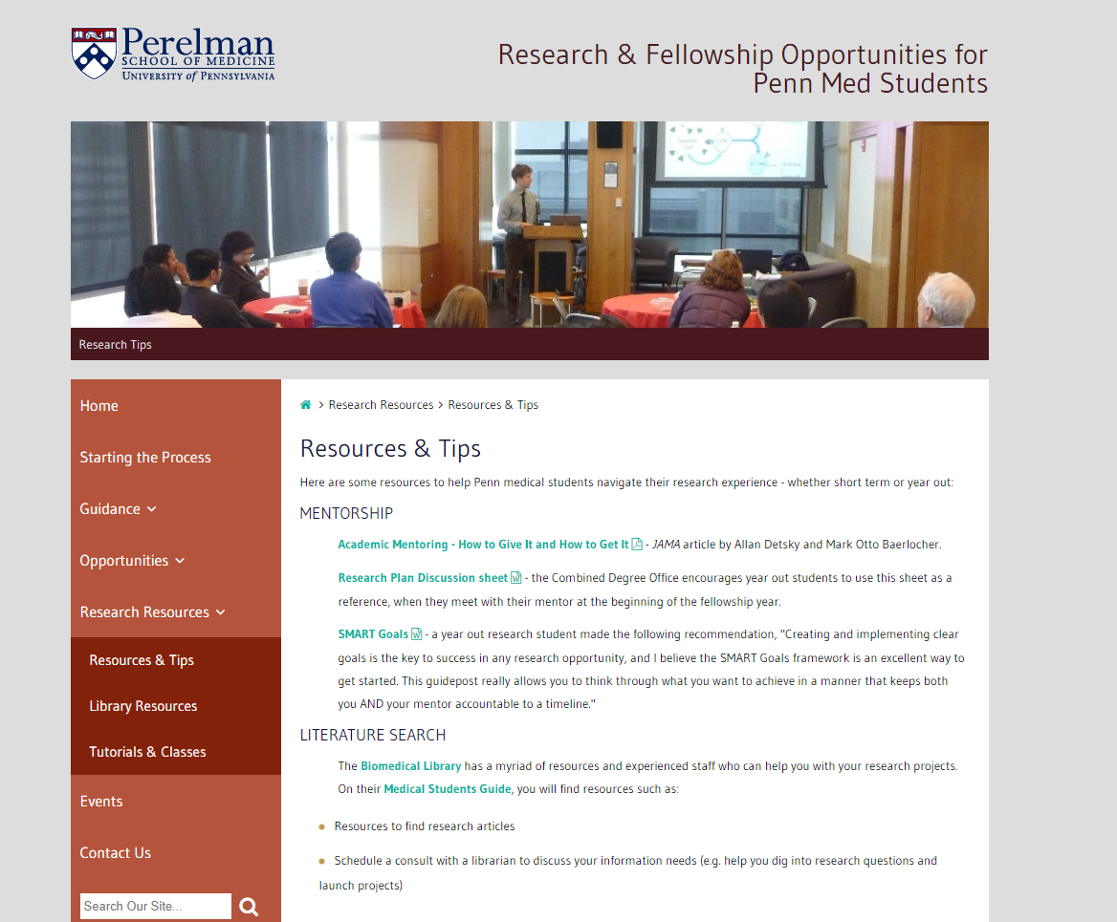
https://www.med.upenn.edu/mdresearchopps/research-resources.html

Slide 22
Research administration at Penn
Student / Mentor Team
Departments & Centers
UPHS
Office of Research Services
Office of Clinical Research
Institutional Review Board

Slide 23
Compliance is part of research
Essential for:
  Legal & regulatory compliance
  Ensuring respect for patients & research participants
  Protecting the community & preserving trust
  Supporting the future of the research enterprise
For students, opportunities to learn how to work effectively and lead within a large, matrixed organization
Ensuring best practices is everyone’s responsibility

Slide 24
Special Session: IRB Review and Human Subjects Research Protections at Penn
2-3 PM Monday, November 15 via Zoom
Jess Yoos (Penn IRB)
Laura Fluharty (Penn OCR)
Mark Neuman (Assoc. Faculty Director for Med Student Scholarship)
All PSOM students involved in human subjects research are encouraged to attend

Slide 25
What is an Institutional Review Board (IRB)?
The Institutional Review Board (IRB) is an ethics committee
  Formally designated in federal regulations to review, approve and monitor biomedical and behavioral research to ensure the safety, rights, and welfare of human participants are adequately protected
An IRB is comprised of a diverse group of scientists, non-scientists, and community members.
Penn has 7 biomedical committees and 1 social-behavioral committee
  The committees are supported by the IRB Office, which is comprised of 23 staff members

Slide 26
What is human subjects research?
What is research? “A systematic investigation, including research development, testing and evaluation, designed to develop or contribute to generalizable knowledge.”
What is a human subject? “A living individual, about whom an investigator conducting research obtains: (1) Data through intervention or interaction with the individual, OR (2)Identifiable private information.”
Activities that may not meet the regulatory criteria for research and/or do not involve human subjects:
  Quality / performance improvement activities
  Journalistic activities (oral history, journalism, biography, literary criticism, legal research, or historical scholarship).
Human Subjects Research Determination Form available online here: https://irb.upenn.edu/mission-institutional-review-boardirb/guidance/types-research

Slide 27
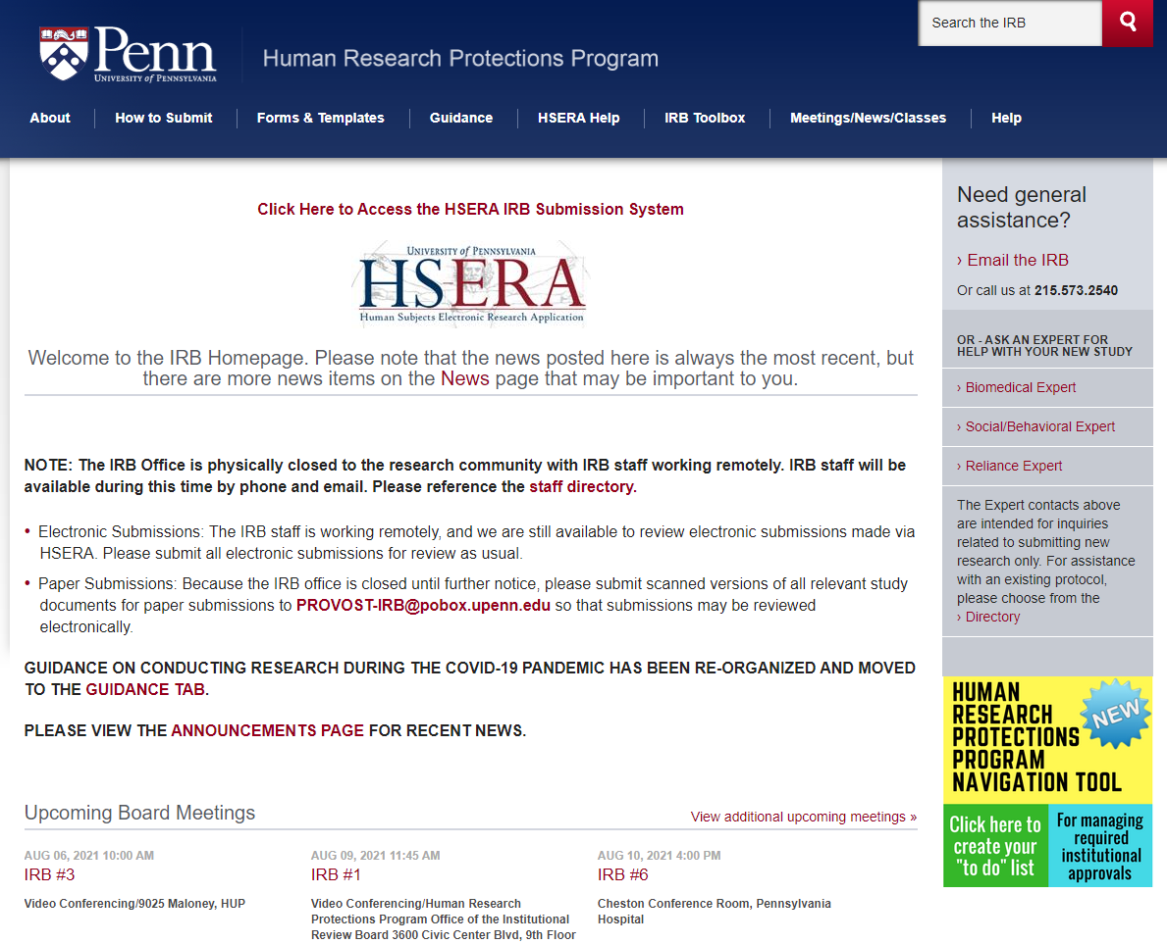
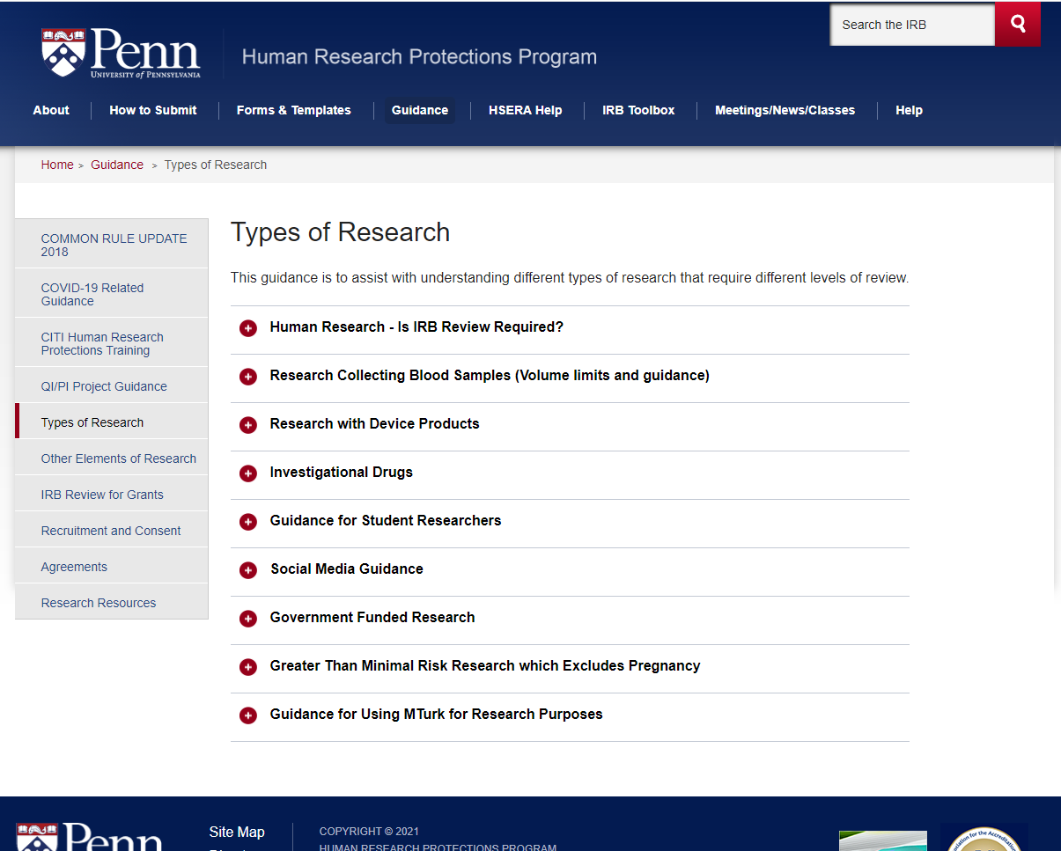
https://irb.upenn.edu/

Slide 28
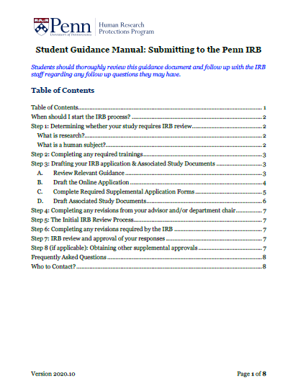
START HERE!→
Penn IRB Student Handbook: https://irb.upenn.edu/sites/default/files/Student%20Guidance%20Manual_2020.11_FINAL.pdf
Note: CHOP maintains a separate IRB; for CHOP-specific details, visit: https://irb.research.chop.edu/

Slide 29
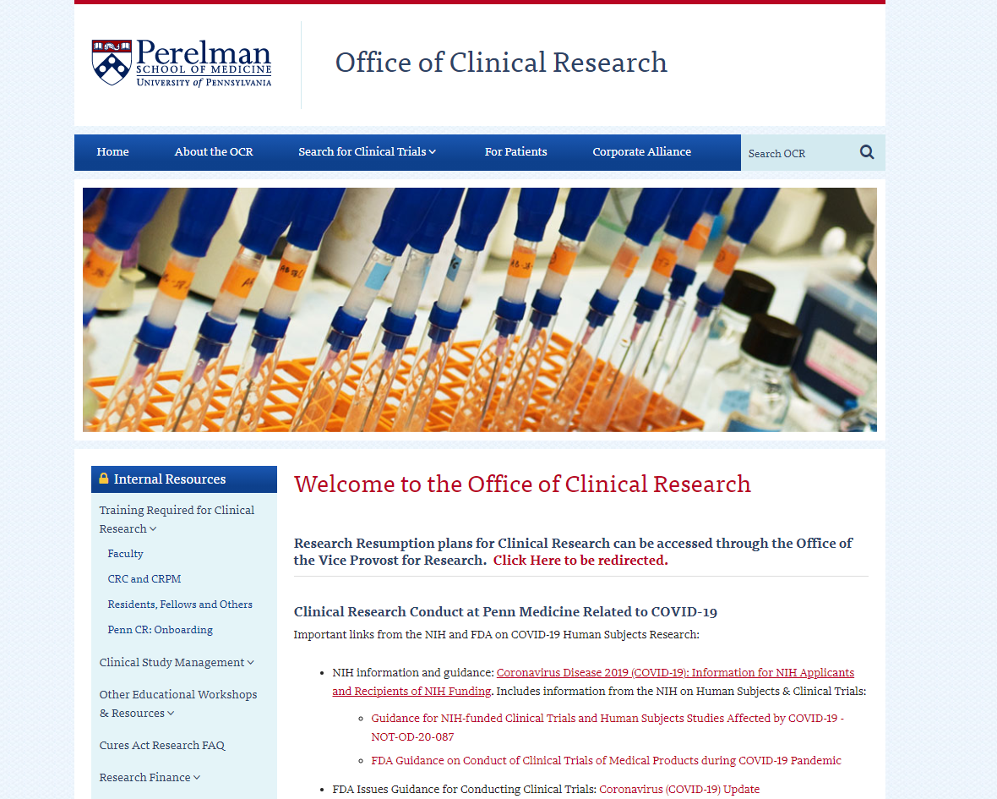
https://www.med.upenn.edu/ocr/
Required training for human subjects research at Penn (all in Knowledge Link)
  CITI Protection of Human Subjects Course
    COURSE UP.83016.ITEM.CITI-HSR
    Access instructions available via link below
  Protecting Patient Information (HIPAA)
    COURSE HS.30006.ITEM.HIPAA_Y19
  Conflict of Interest Research Investigator Training
    COURSE UP.91028.ITEM.FCOI
  Introduction to Good Clinical Practice Guidelines (clinical trials only)
    COURSE UP.40009.ITEM.2HRACRPGCP
CITI Instructions for access: https://irb.upenn.edu/sites/default/files/2017-06_CITI%20Training%20for%20the%20First%20Time-New%20for%20website.pdf
KnowledgeLink: https://knowledgelink.upenn.edu/

Slide 30
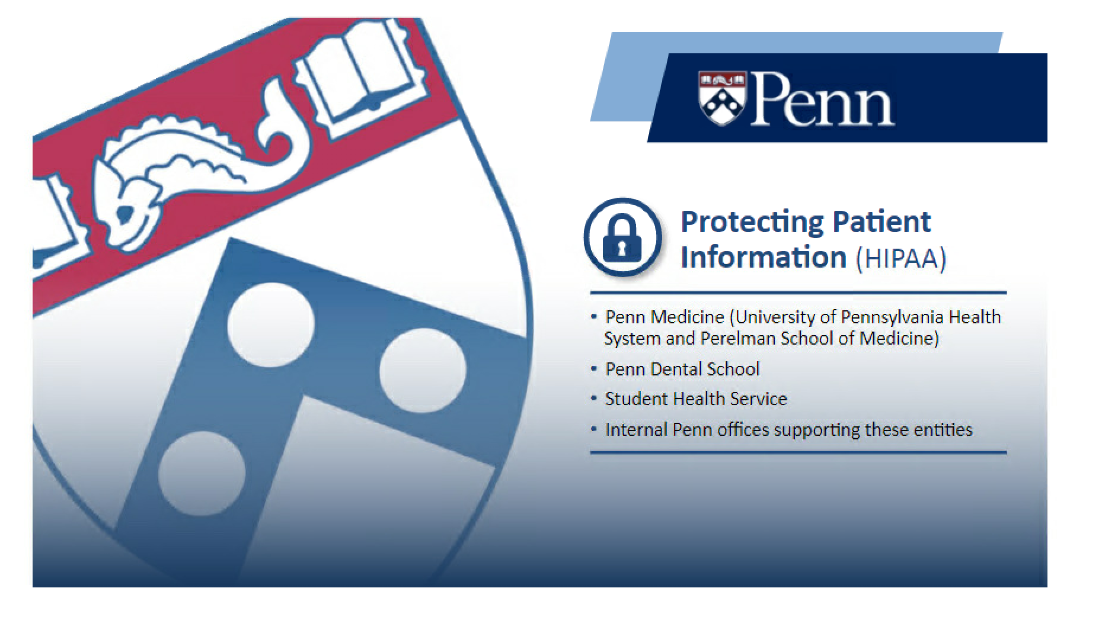
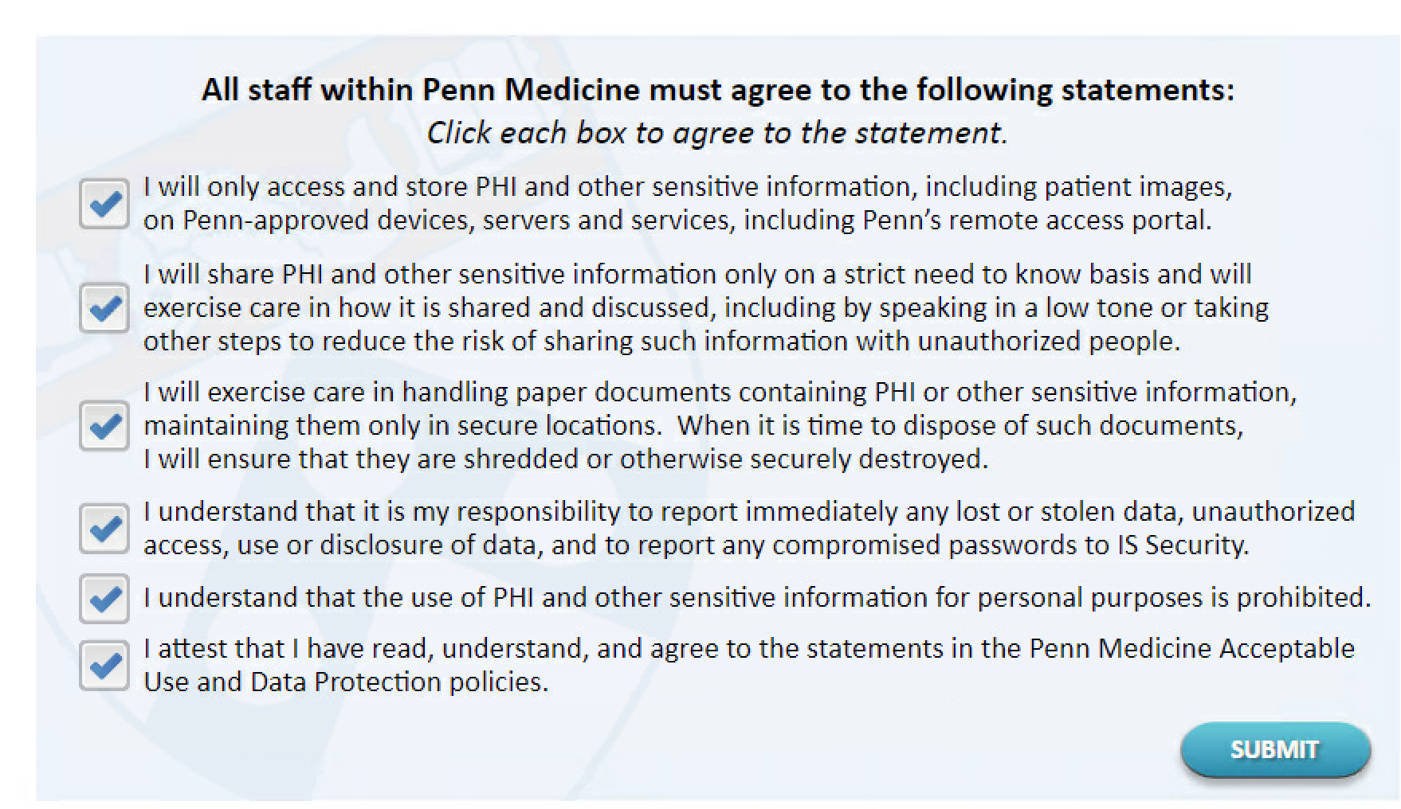
  Protecting Patient Information (HIPAA) COURSE HS.30006.ITEM.HIPAA_Y19
SAMPLE
Note: Presented content applies to Penn entities; compliance for CHOP projects handled through CHOP Research Institute
Selected required assurances shown: see KnowledgeLink for full required assurance list

Slide 31
What is PHI (protected health information)?
Names (Full or last name and initial)
All geographical identifiers smaller than a state, except for the initial three digits of a zip code (if all included ZIPs contain > 20,000 people)
Dates (other than year) directly related to an individual
Phone Numbers
Fax numbers
Email addresses
Social Security numbers
Medical record numbers
Health insurance beneficiary numbers
Account numbers
Certificate/license numbers
Vehicle identifiers (including serial numbers and license plate numbers)
Device identifiers and serial numbers;
Web Uniform Resource Locators (URLs)
Internet Protocol (IP) address numbers
Biometric identifiers, including finger, retinal and voice prints
Full face photographic images and any comparable images
Any other unique identifying number, characteristic, or code except the unique code assigned by the investigator to code the data

Slide 32
Selected Data Storage and Analysis Options for Penn Researchers
Data Includes Protected Health Information (PHI)* | Without PHI
RedCap | Excel
Penn + Box – PSOM faculty, staff, and students | Access
Penn Medicine 365 Applications – OneDrive, Teams, Sharepoint | RedCap
For more data management information - https://www.med.upenn.edu/ocr/data-management.html
* Means Tools are Considered HIPAA compliant

Slide 33
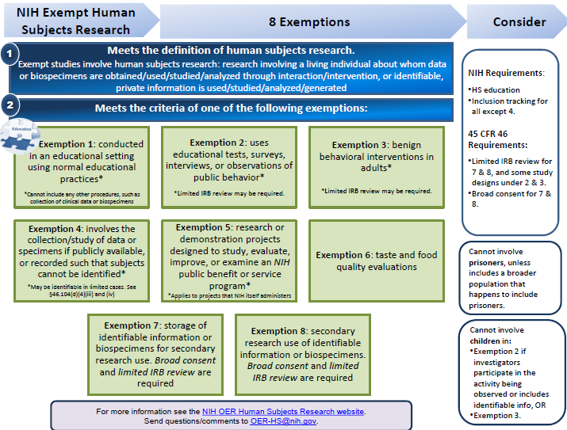
https://grants.nih.gov/sites/default/files/exemption_infographic_v8_508c_1-15-2020.pdf

Slide 34
IRB submission not required
IRB submission required (analyst review)
Examples of Exempt Studies
Examples of Expedited Studies
Research with drug / device products that is exempt from FDA IND & IDE regulations
Not Human Subjects Research (NHSR)
Not Research Example:
Using existing publicly available data (e.g., anyone can download from internet)
Benign behavioral interventions with adults
Secondary research with non-sensitive data or specimens
Surveys/ interviews/ focus groups with adults collecting non-sensitive data
Receiving identifiable data from data registries or research studies
Chart reviews
Research involving cadavers
Venous or fingerstick blood collection considering frequency, amount, and subject
Non-invasive collection of saliva, hair, nails, teeth, skin swab, sputum, etc.
Collection of data via non-invasive means (e.g., MRI without contrast, EEG, ECG, pulse ox, etc.)
Risks must be minimal
Not involving HS Examples:
Quality Improvement (not intended to produce generalizable knowledge)
Receiving identifiable biospecimens from a repository or biobank where broad consent was obtained
Research w/leftover identifiable clinical specimens
Case study of 3 or fewer patients
Research in educational settings
Receiving de-identified data or specimens where no link exists with identifiers
Notes:
NHSR: As defined by DHHS: “Research is a systematic investigation, including research development, testing and evaluation, designed to develop or contribute to generalizable knowledge.” Therefore, to meet this qualification the project would need to be determined to not be research OR not involve human subjects.
FDA regulations defines a human subject to be an individual (healthy volunteer or patient) who is a recipient of an FDA regulated product (e.g., drug, biologic, device, dietary supplement, etc.) or a control.

Slide 35
Not Human Subjects Research
No review required
Exempt or Limited IRB Review*
Initial Review Required
Minimal Risk w/ Expedited* or Full Review
Initial Review Required
Greater than Minimal Risk w/ Full Review
Initial Review Required
Modifications Required
Modifications Required
Continuing Review Required
Continuing Review required if informed by IRB
Modifications with Limited Review
*Review completed by IRB analyst (staff) team; full board review not required
Notes:
The only biomedical research that is eligible for exemption from ongoing IRB review are chart reviews/secondary use of biomedical specimens. Everything else requires expedited or convened review. Anything determined to be FDA regulated requires continuing review regardless of risk (at this time). Per FDA. This would be any clinical investigation. Any study investigating a drug or device OR any study administering a drug product.

Slide 36
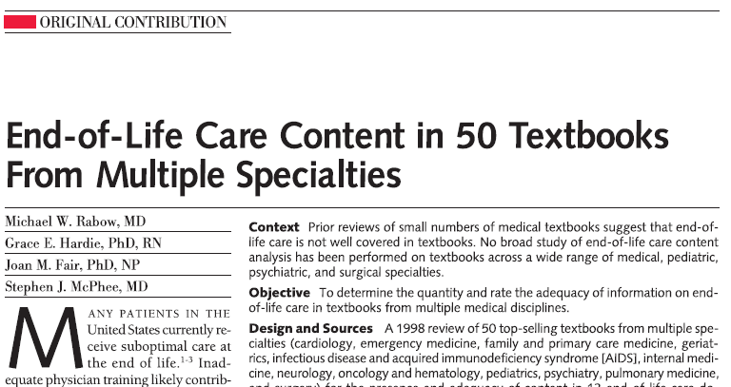
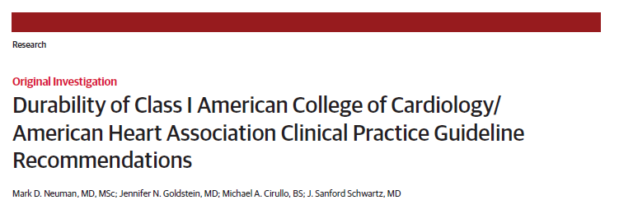
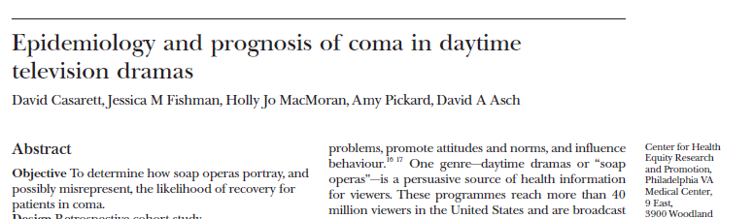
Exempt and non-human subjects research can have major impact

Slide 37
General guidance
Start early and ask questions
  Talk to your PI
  Don’t hesitate to reach out to the IRB & Student Scholars team
As a general rule, if the research is being done at Penn, the Penn IRB needs to be consulted, even if it is already approved by a non-Penn IRB
  NOTE: CHOP and Penn are separate entities & have separate IRBs; work conducted at both locations need engagement of both Penn and CHOP IRBs
Try to right-size the level of complexity/risk with the time you have
  Non-human subjects research, exempt, or expedited options may be feasible on limited time/budget
  More complex projects involving full board review (RCTs, prospective cohort studies) will require more time and effort
Don’t take shortcuts. The IRB is there to protect you, the institution, and (most importantly) research participants. Compliance is everyone’s responsibility.

Slide 38
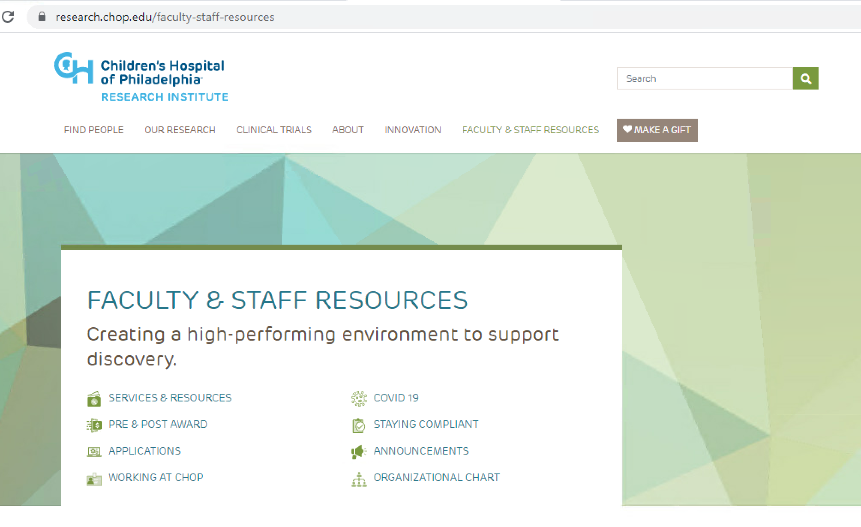
http://Research.chop.edu

Slide 39
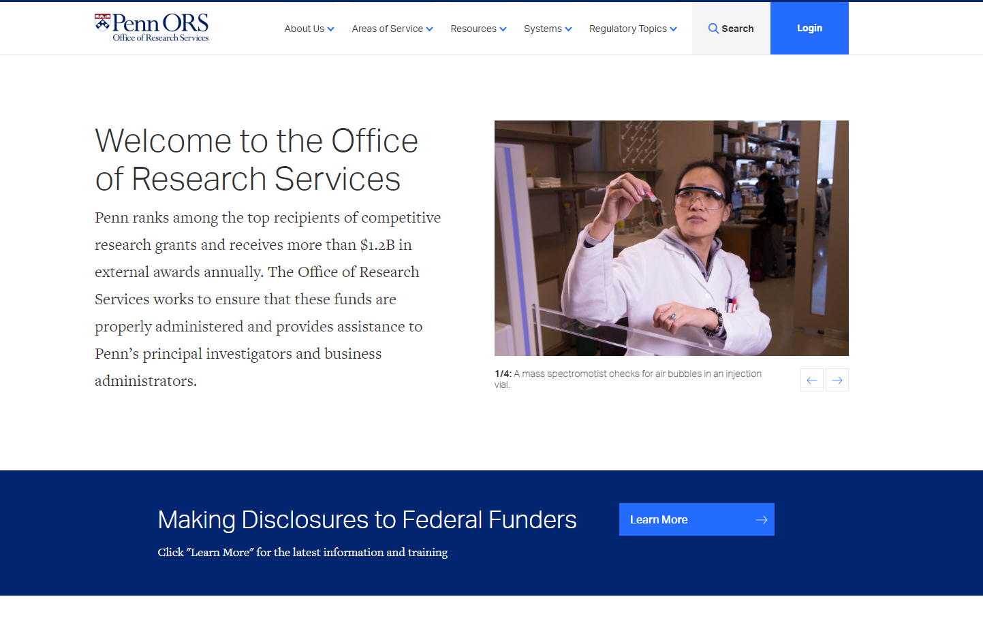
https://researchservices.upenn.edu/
Manages relationships b/w Penn & external funders
Ensures uniform financial compliance in grants/contracts administration across Penn
  Grants/contract administration oversight support (Pre- & Post-award)
  Subaward management
  Data Use Agreements
  “Authorized Official” for signing contract/grant/DUA forms with outside entities.
Funding for research at Penn by NIH, Foundations, and others typically occurs as a grant made to the institution (Penn) on an investigator’s behalf. ORS is the official representative of the institution in most of these arrangements.

Slide 40
Upcoming Sessions
September 20th 2:15-3:15 PM: Finding mentors and research projects
September 30th 5:45-6:45 PM: Research year out informational session
November 15th 2-3 PM: IRB & human subjects research basics for PSOM students
All sessions will be held on Zoom

Slide 41
Questions?
Mark Neuman: neumanm@pennmedicine.upenn.edu
Francia Portacio: francia.portacio@pennmedicine.upenn.edu

